Slide 1






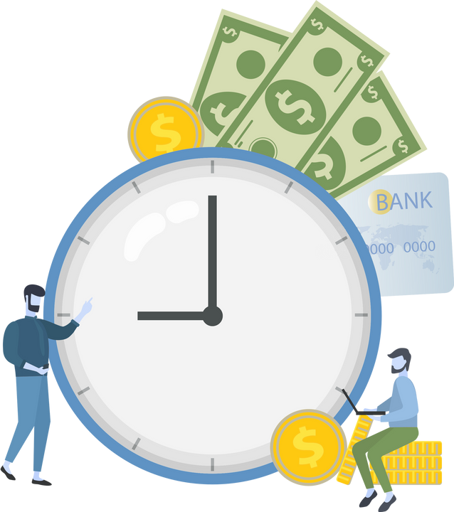






Queute
Because every minute counts
1

Slide 2
Content
01.
Problematic of the Project
02.
Advantages of the Cloud Infrastructure
03.
Application Overview
04.
Value & Benefits
Sustainable Development Goals (SDGs)
05.
06.
Technological Stack
07.
Promotional Video Capsule
08.
Context of Application Choice
2

Slide 3

Problematic of the Project
3

Slide 4
Long wait times
Unclear procedures
4

Slide 5

Endless bureaucracy
5

Slide 6
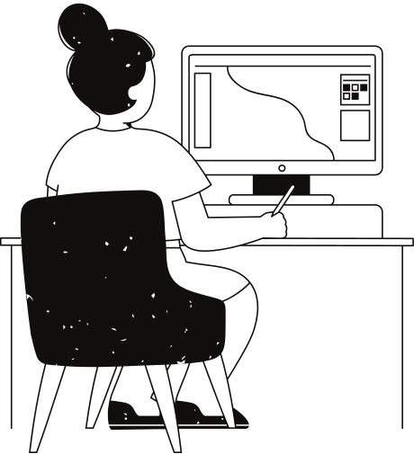
Advantages
of the cloud infrastructure
6

Slide 7





Scalability
disaster recovery
Automatic updates and maintenance
High availability
7

Slide 8

Application
Overview
Queute helps you skip the line, stay updated, and navigate public services with ease.
8

Slide 9




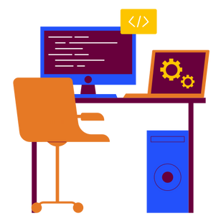


News
User & Organisation
Service
Road Map
Forum
Workspace
Reservation
9

Slide 10
Value and
Benefits
10

Slide 11

Queute is an intermediate between governmental, private sector services and the general public. Our solution enables communications sometimes are even impossible.
Our solution is the link. We are the link.
11

Slide 12



Sustainable Development
Goals (SDGs)
12

Slide 13





Key SDGs Targeted by Our Project:
13

Slide 14

Architecture Overview
14

Slide 15

Global architecture
Ressources
Processor:Ryzen 5
Processor: i5-12450H
Processor: i5-10 gen
RAM: 24Go
RAM: 16GO
RAM: 16GO
Storage: 1T HDD - 128 Go SSD
Storage:512 Go NVMe
Storage:512 Go SSD
15

Slide 16
Global architecture
Ressources
Processor:Ryzen 7
Processor: i7-12700H
Processor: i7-6700H
RAM: 16GO
RAM: 32GO
RAM: 24Go
Storage: 1T HDD - 128 Go SSD
Storage: 1T SSD
Storage: 1T SSD
16

Slide 17
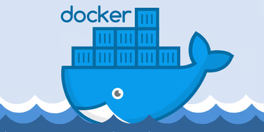

Application
Container
Container
Container
Container
Infrastructure
Hypervisor
OpenStack
Controller
Compute
Storage
17

Slide 18


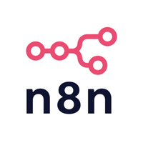
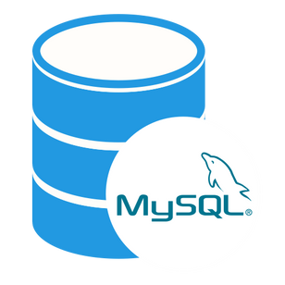




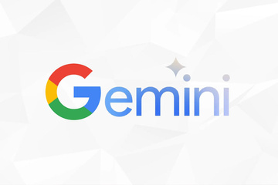
Global architecture
Application
Back-End
Database
Front-End
API’S
18

Slide 19



Key components
Cloud Infrastructure
Benefits
OpenStack
Flexibility and Customization
Private Cloud
19

Slide 20

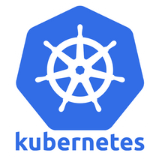
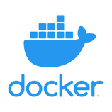
Key components
Orchestration
Heat for infrastucture orchestration
What is orchestration ?
Kubernetes for container orchestration
Orchestration is the automated management and coordination of services or containers to ensure they run smoothly, scale properly, and stay available.
Docker for containerization
20

Slide 21





Key components
Monitoring and Security
Monitoring & Alerts
Security
21

Slide 22



Key components
Automation
Benefits
Ansible
Easy to Learn and Use
Saves Time
22

Slide 23

Context of the application
choice
23

Slide 24

we noticed the need of this type of ideas in Tunisia.
It would definitely change everyone’s life for the better!
24

Slide 25
we were inspired by real life events.
Getting passports and changing documents.
25

Slide 26
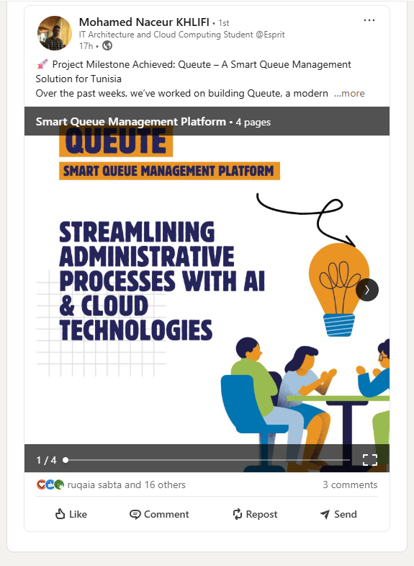
Linkedin
Post
https://www.linkedin.com/posts/mohamed-naceur-khlifi-0b5a9227a_smart-queue-management-platform-activity-7329747382995214336-4mTG?utm_source=share&utm_medium=member_desktop&rcm=ACoAADu4OcABnfE5rSMj6gdlMGYokCVvchD0a_Y
26

Slide 27
Thank you very much!
27

